Slide 1

KIET GROUP OF INSTITUTIONS GHAZIABAD
DEPARTMENT OF COMPUTER SCIENCE & INFORMATION TECHNOLOGY
TITLE – WEATHER PORTAL
SUBMITTED BY :
SHIVAM AGARWAL
1900290110102
CSI-B
SUBMITTED TO :
Prof. Om Prakash Kushwaha

Slide 2
INTRODUCTION
Weather forecasting is the application of science and technology to predict the conditions of the atmosphere for a given location and time.
Human beings have attempted to predict the weather informally for millennia and formally since the 19th century.
Weather forecasts are made by collecting quantitative data about the current state of the atmosphere at a given place and using meteorology to project how the atmosphere will change.

Slide 3
WEATHER FORECASTING IMPORTANCE:
Climatology and Weather Forecasting is important since it helps determine future climate expectations. Through the use of latitude, one can determine the likelihood of snow and hail reaching the surface.
Climatology is the scientific study of climates, which is defined as the mean weather conditions over a period of time.
A branch of study within atmospheric sciences, it also takes into account the variables and averages of short-term and long-term weather conditions.
Meteorology focuses more on current weather conditions such as humidity, air pressure, and temperatures and forecasting the short-term weather conditions to come.

Slide 4
PURPOSE OF PROJECT
The purpose of developing weather is to fetch the data in the need of taking information about weather worldwide.
Another purpose for developing this software is to generate the report automatically at the end of the session or in the between of the session.
Observing the daily weather is part of a regular routine for many of us, helping us decide what to wear and which activities we will do each day.
Similar observations of atmospheric conditions are also required by meteorologists to develop those weather forecasts with which we are all familiar.

Slide 5
AIMS & OBJECTIVES
Weather warnings are important forecasts because they are used to protect life and property.
Forecasts based on temperature and precipitation are important to agriculture, and therefore to traders within commodity markets.
Temperature forecasts are used by utility companies to estimate demand over coming days.
Since outdoor activities are severely curtailed by heavy rain, snow and wind chill, forecasts can be used to plan activities around these events, and to plan ahead and survive them.

Slide 6
STEPS INVOLVED:
Find a weather API
Find weather icons.
Define the page markup.
Specify some basic styles.
Set the main styles.
Add java script.

Slide 7
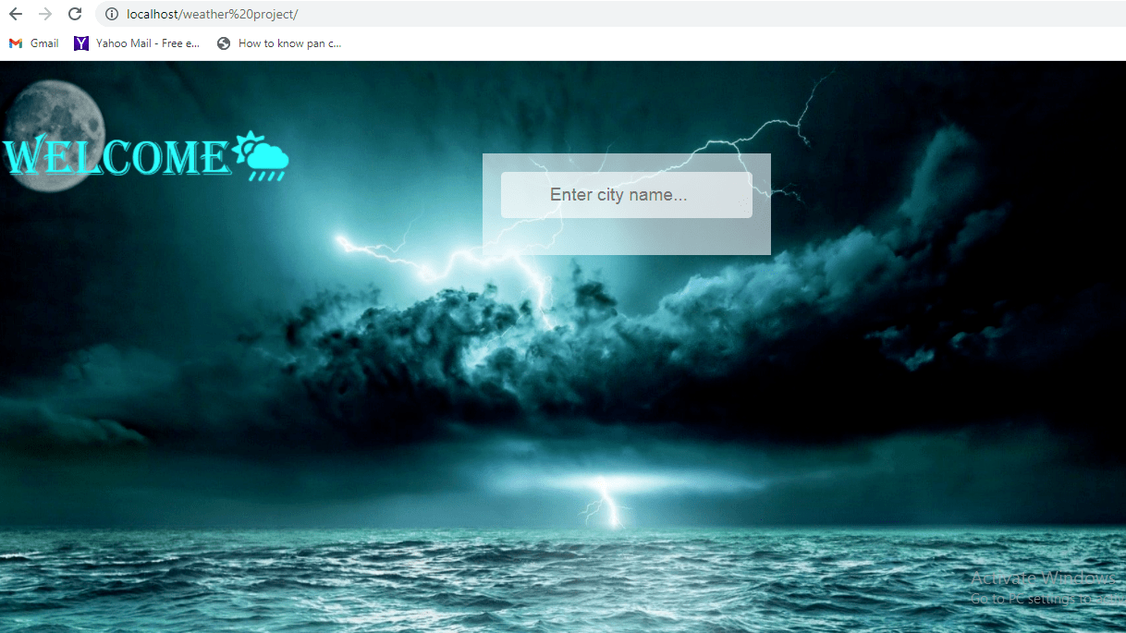
Home Page –

Slide 8
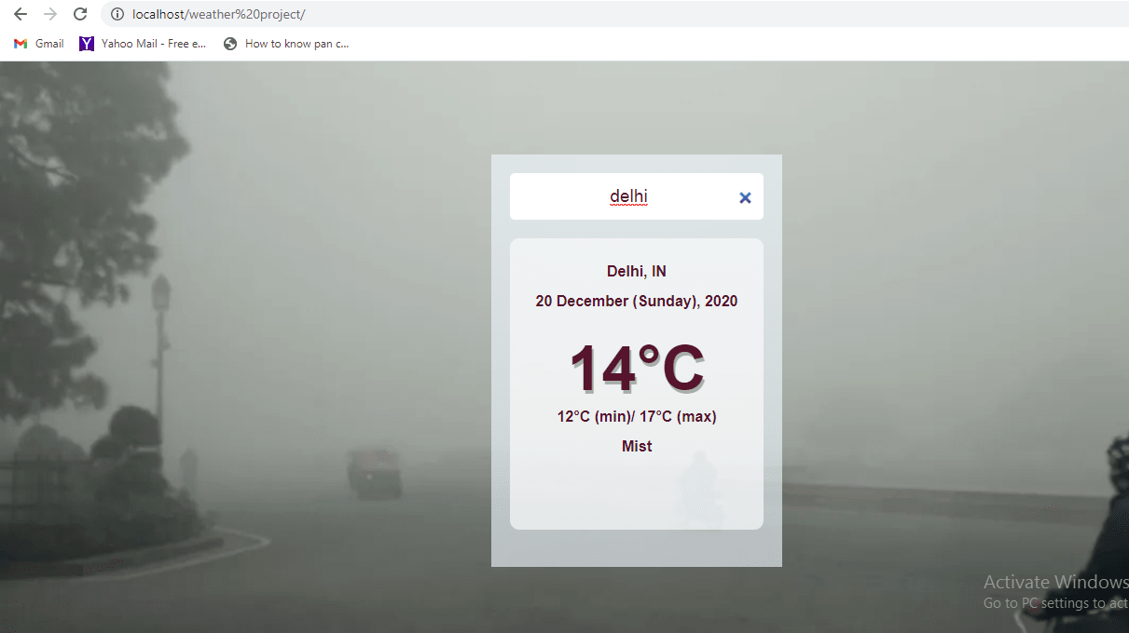
Weather Details –

Slide 9
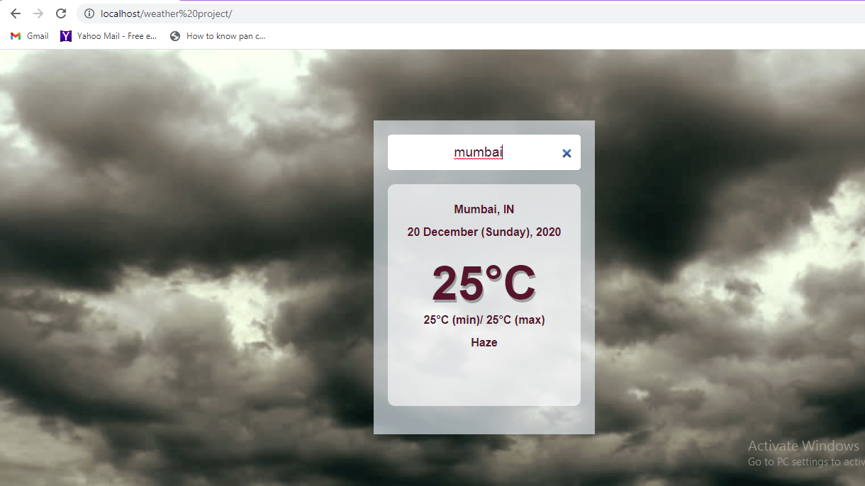
HAZE:

Slide 10
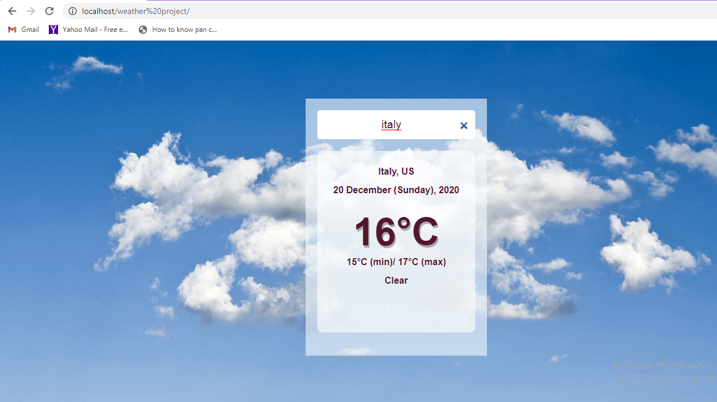
CLEAR SKY:

Slide 11
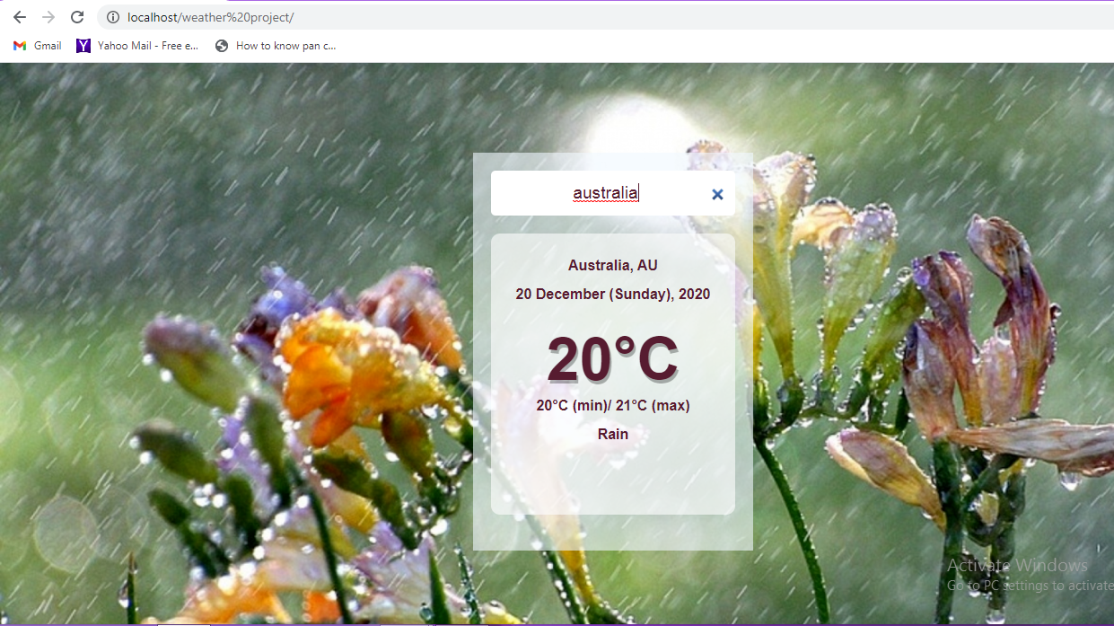
RAIN:

Slide 12
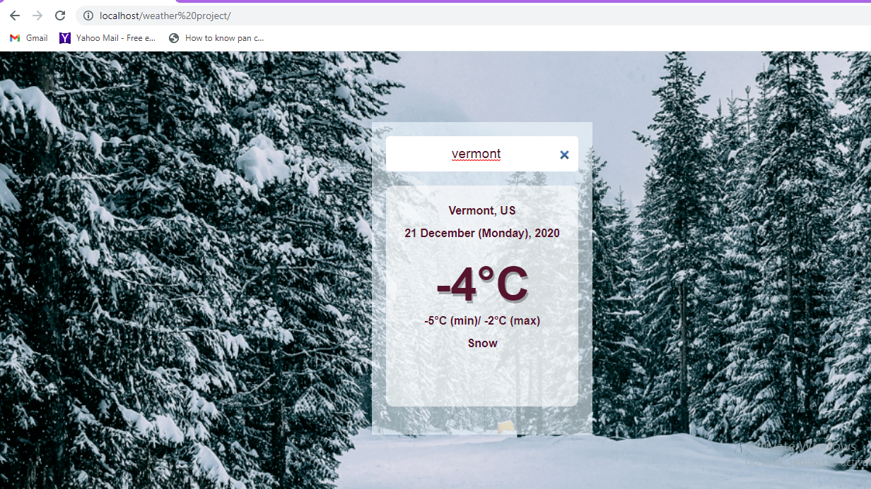
SNOW:

Slide 13
LANGUAGES USED:
HTML:
HTML stands for Hypertext Markup Language. It allows the user to create and structure sections, paragraphs, headings, links, and blockquotes for web pages and applications.
CSS:
CSS stands for Cascading Style Sheets. CSS describes how HTML elements are to be displayed on screen, paper, or in other media.
JAVA SCRIPT:
JavaScript is a text-based programming language used both on the client-side and server-side that allows you to make web pages interactive.

Slide 14
CONCLUSION
Climate change is expected to affect flooding through changes in rainfall, temperature, sea level and river processes.
Climate change will exacerbate the existing effects of flooding on infrastructure and community services, including roads, stormwater and wastewater systems and drainage, river flood mitigation works, and private and public assets including houses, businesses and schools.
If we know about the present weather then we can avoid travelling to unfavourable conditions.
Weather forecast helps the farmers to know when to apply the pests and chemicals to avoid the crop wastage.

Slide 15
REFERENCES
www.accuweather.com
www.sciencedaily.com
www.nationalgeographic.com
www.weather-forecast.com

Slide 16
THANK YOU

